Slide 1
Flight price prediction

Slide 2
contents
Overview
Problem Statement
What is Flight Price Prediction
Exploratory data analysis
Visualization
Model Building
Hyper parameter tuning
Saving the Model
Conclusion

Slide 3
Overview
In this presentation we will look at
How to analyze the dataset
Steps to clean the dataset
Overall analysis of he data
Building a model
Predicting the prices

Slide 4
Problem statement
Anyone who has booked a flight ticket knows how unexpectedly the prices vary. The cheapest available ticket on a given flight gets more and less expensive over time. This usually happens as an attempt to maximize revenue based on –
Time of purchase patterns (making sure last-minute purchases are expensive)
Keeping the flight as full as they want it (raising prices on a flight which is filling up in order to reduce sales and hold back inventory for those expensive last-minute expensive purchases)
So, you have to work on a project where you collect data of flight fares with other features and work to make a model to predict fares of flights.

Slide 5
What is flight price prediction?
Nowadays, the number of people using flights has increased significantly. It is difficult for airlines to maintain prices since prices change dynamically due to different conditions. That’s why we will try to use machine learning to solve this problem. This can help airlines by predicting what prices they can maintain. It can also help customers to predict future flight prices and plan their journey accordingly.

Slide 6
Exploratory data analysis
Firstly, I imported the dataset using the necessary libraries
Since there as datetime feature, I extracted the day and month, year wasn’t necessary as al the data was from the same year
There were same airway companies with different names, so I changed the names and made them all the same
The data set had only 1 null value, so I filled it with the necessary data
After which I proceeded with visualization

Slide 7
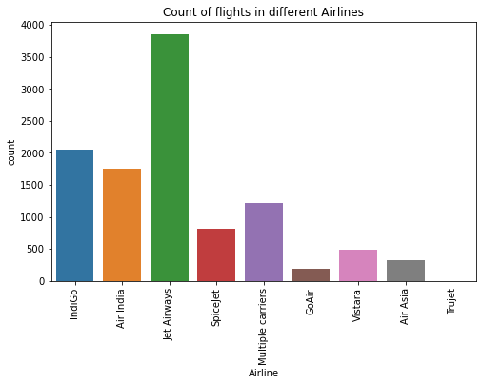
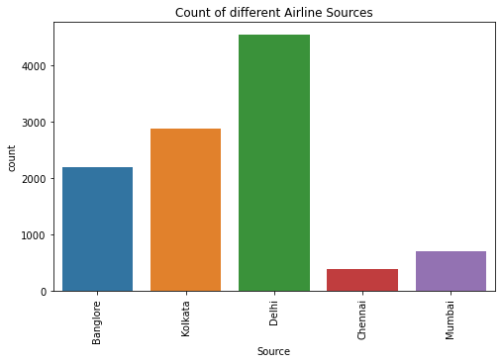
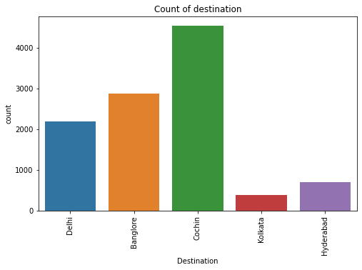
Visualization(Univariate)

Slide 8
From the first graph on the previous slide we observe that Jet Airways flights has high counts whereas Trujet and GoAir has the least counts.
From the second graph on the previous slide we observe that the Journey of many flights begin from Delhi and least from Chennai
From the third graph on the previous slide we observe that the destination of most of the Flights is Cochin and least is Kolkata

Slide 9
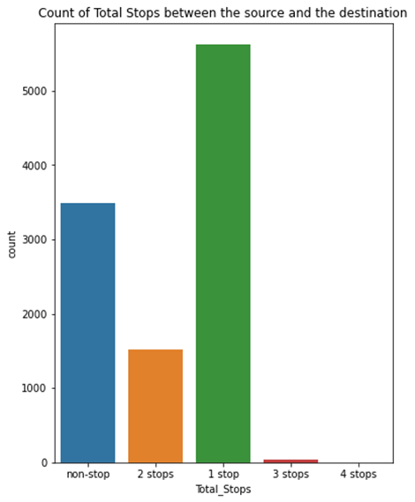
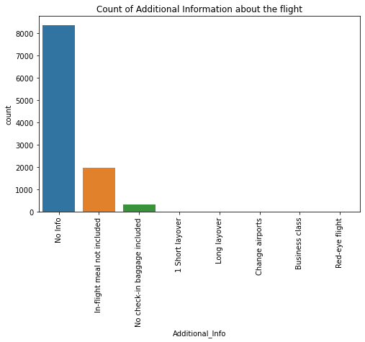

Slide 10
From the first graph on the previous slide we observe that most of the flights have 1 stop and very few flights have 4 stops between the source and destination.
From the second graph on the previous slide we observe that most of the flights do not have any additional information

Slide 11
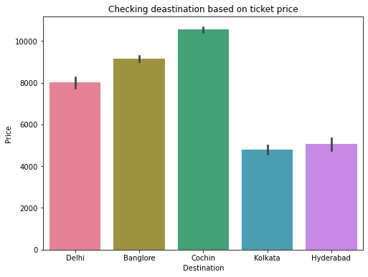
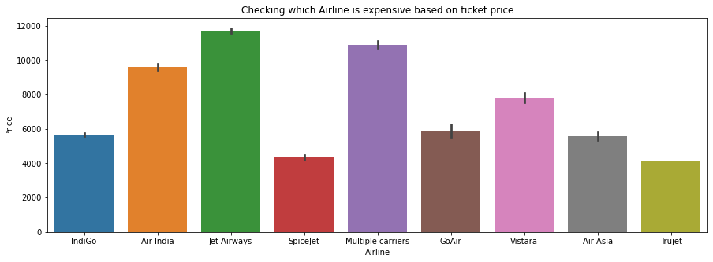
Visualization(bivariate)

Slide 12
The first graph from the previous slide we that Jet Airways is most expensive Airline followed by Multiple carriers followed by Air India. Trujet and Spicejet have low ticket prices compared to the other Airlines.
From the second graph on the previous slide we observe that the ticket price is the highest when the destination is Cochin

Slide 13
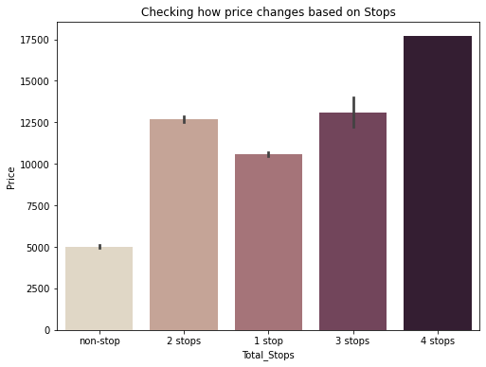
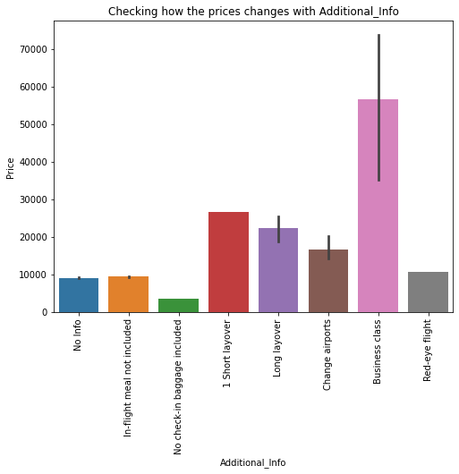
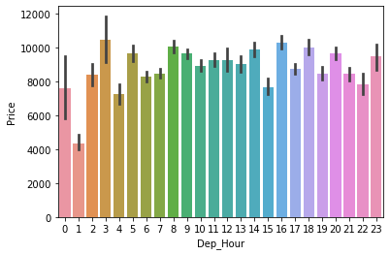

Slide 14
From the first graph on the previous slide we can see that when there are 4 stops the price of the ticket is the highest and when there are no stops the price the price of the ticket is the least
From the second graph on the previous slide we observe the following
The price of Business class tickets is the highest.
When there is no checkin baggage the price of the ticket is the least.
From the third graph we can observe that Departure hour doesn't impact the ticket price much

Slide 15
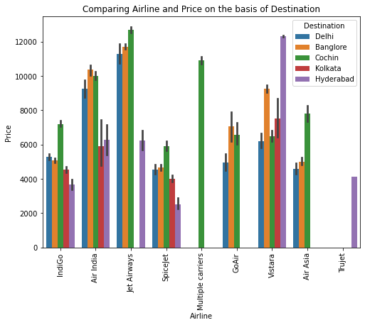
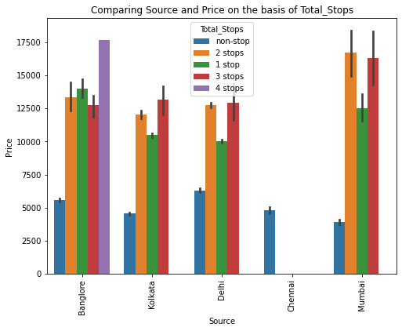

Slide 16
From the first graph on the previous slide we can observe the following
Jet Airways flights with the destination as Delhi have the highest ticket price.
Indigo flights with the destination as Cochin has the highest price.
Air India flights with the destination as Bangalore have the highest ticket price.
SpiceJet ticket price is the highest when the destination is Cochin
GoAir ticket prices are almost he same when the destination is Cochin/Banglore
Vistara ticket prices is the highest when the destination is Hyderabad
Air Asia ticket price is the highest when the destination is Cochin
From the second graph we can observe the following
The flights with 4 stops and the source as Bangalore has the highest ticket price.
Only non-stop flights start from Chennai.
The price of tickets is highest when there are 2 stops are source of the flight is from Mumbai.

Slide 17
Model building
In this project, “Price” is out target variable and it is continuous so I have used different Regression algorithms to find the best model to predict the price of the flight ticket
I have used the following models:
Random Forest Regression
Decision Tree Regression
Gradient Boosting Regression
XGB Regression

Slide 18
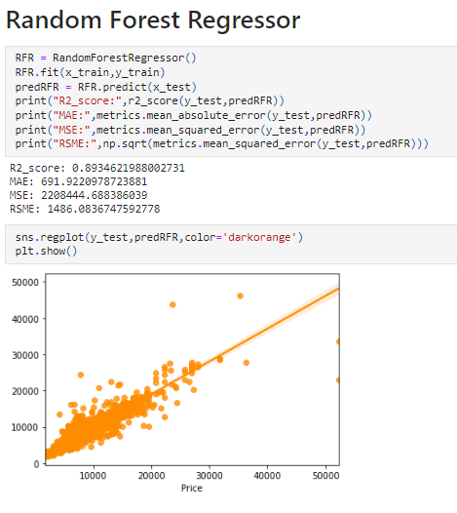
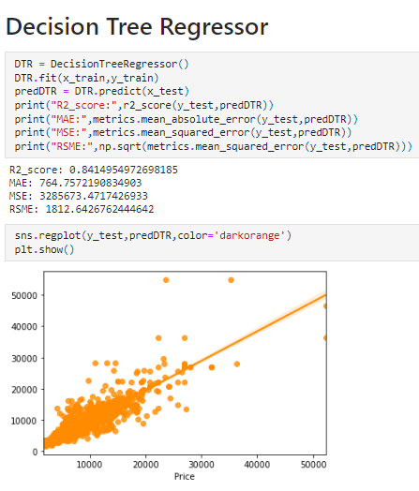

Slide 19
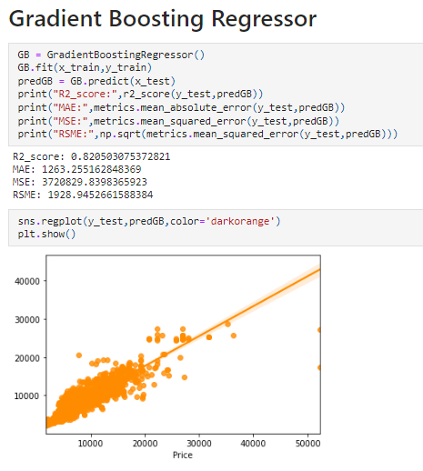
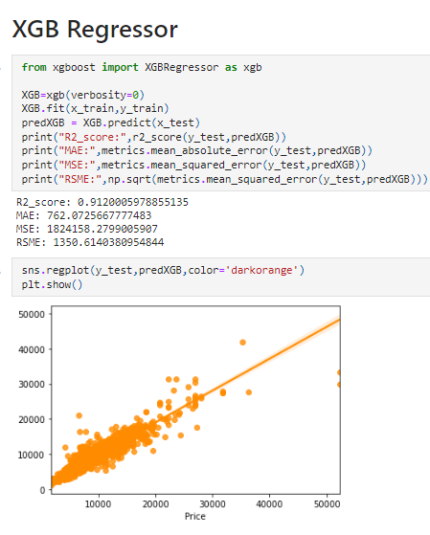

Slide 20
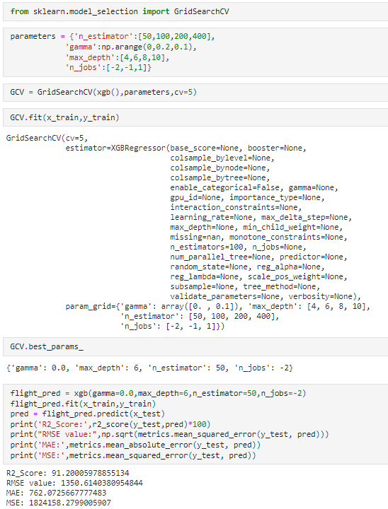
Hyper parameter tuning
After building the different models, and checking their cross-validation scores, I came to a conclusion that XGB Regressor gave me the best R2 score.
I got R2 score of 91.2% after hyper tuning the parameters

Slide 21
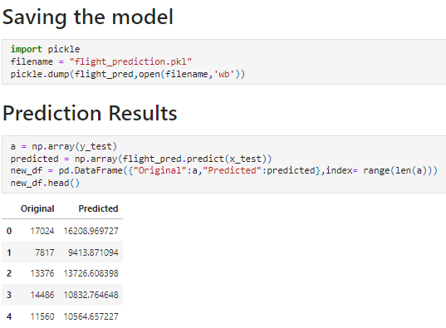
Saving the model and predicting the results

Slide 22
conclusion
The case study aims to give an idea of applying Machine Learning algorithms to predict the price of the flight tickets. After the completion of this project, we got an insight of how to collect data, pre-processing the data, analyze the data, cleaning the data and building a model.
So as we saw that we have done a complete EDA process, getting data insights, feature engineering, and data visualization as well so after all these steps one can go for the prediction using machine learning model-making steps.

